Slide 1
Registration workflow
editor: 陳興彥

Slide 2
Outline
Installation
ABBA
QuPath
ABBA-Qupath extension
Registration
Create project, import images
ABBA
Analysis
Cell detection
Insert to hierarchy
Full tutorial documentation
Follow the official documentation as the primary reference; this ppt is for support.

Slide 3
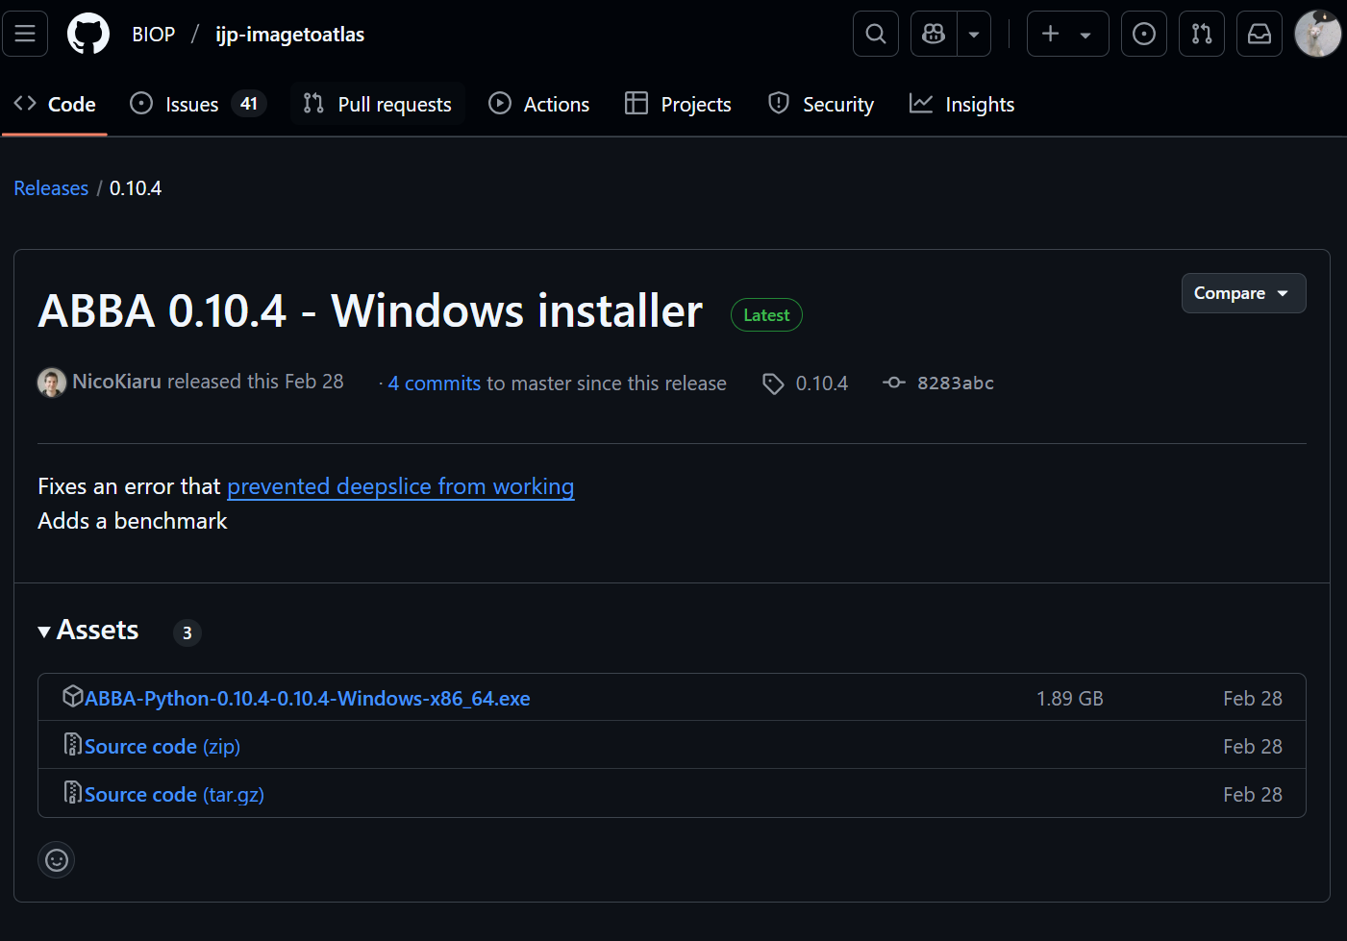
Installation-ABBA
There are three methods to control ABBA installation within Fiji:
Use standalone Windows installer
automatic installer
Download this

Slide 4
Installation-Qupath
https://qupath.github.io/

Slide 5
Installation-Qupath extension for ABBA
ABBA extension
download the latest ABBA extension zip file (named qupath-extension-abba-x.y.z.zip);
unzip it;
Open Qupath; drag-and-drop the .jar files into QuPath’s main window;

Slide 6
Qupath-Create project and import images
Qupath/File/Project/Create project
Choose an empty folder
Drag and drop your images into the QuPath project.
Select Bio-Formats builder for Image provider and click Import.

Slide 7
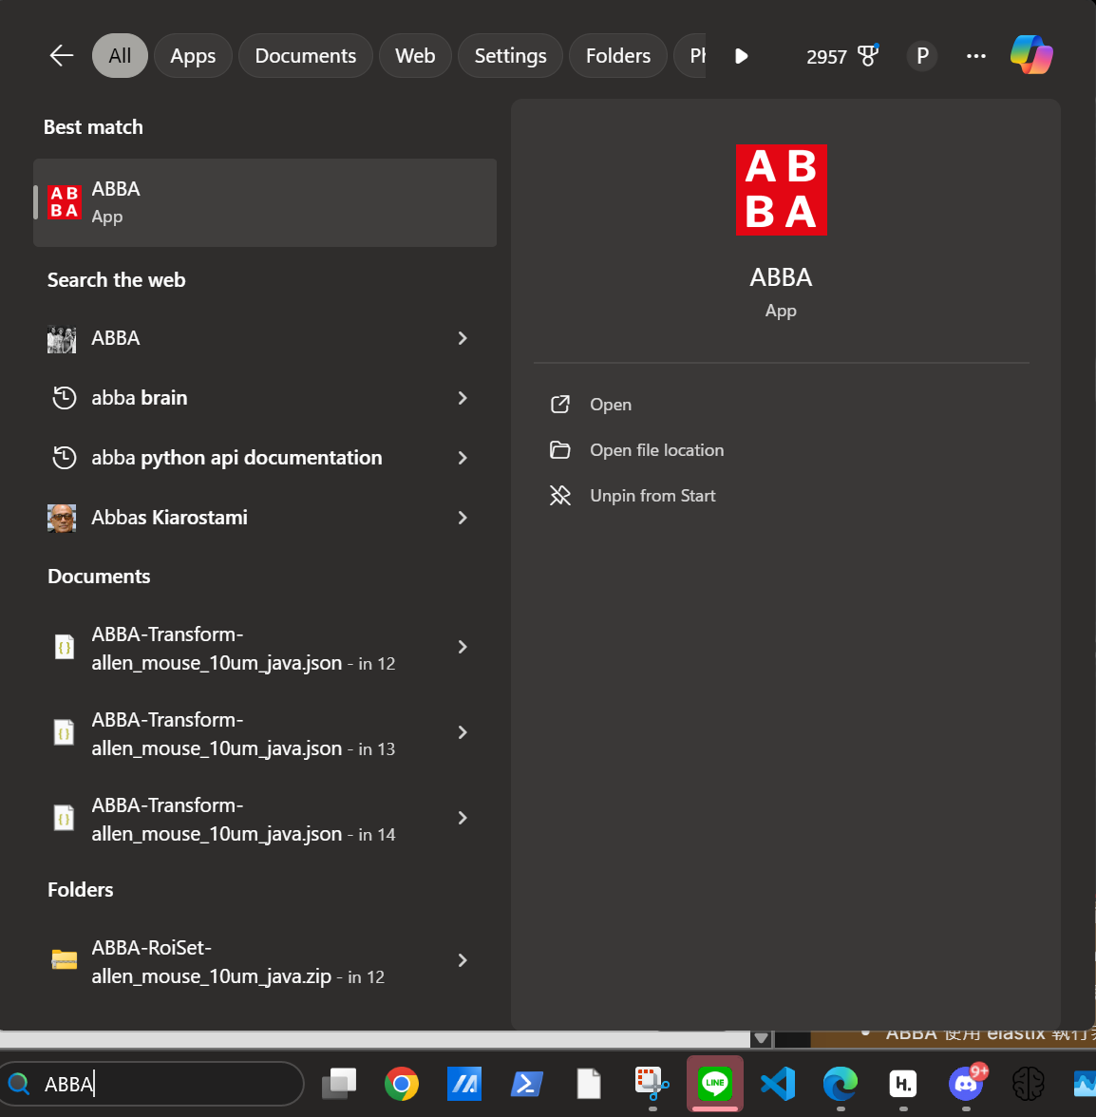
ABBA-Start
Start ABBA by searching in search bar
Fiji/Plugins/BIOP/Atlas/ABBA-ABBA start
Choose an atlas->allen_mouse_10um_java
Orientation->coronal

Slide 8
ABBA-Import Qupath project
Import/Import Qupath project
Go to the Qupath project folder and select project.qpproj
Initial axis position->0.01
Axis increment between slices->0.05

Slide 9
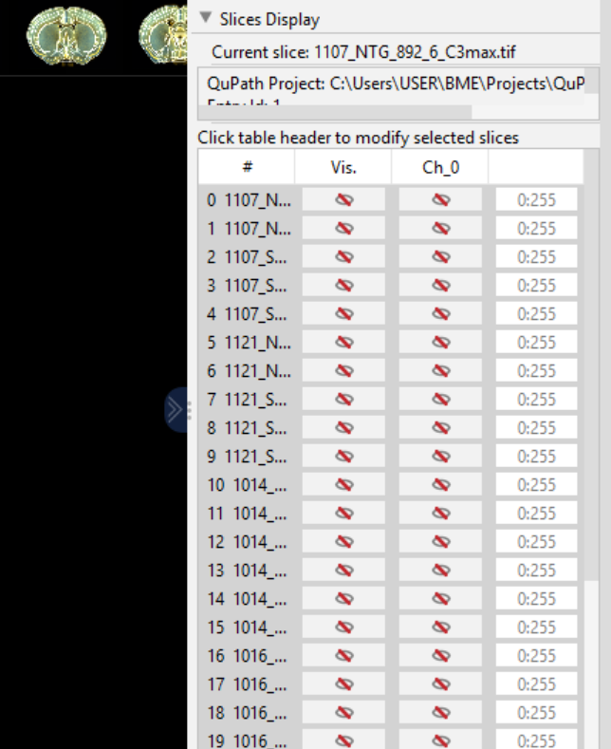
ABBA-Show Slices on the screen
Ctrl+A to select all Slices
Right bar/Slices Display
Click Vis. and Ch_0 to show all slices

Slide 10
ABBA-adjust contrast
adjust the color, and the minimum and maximum display values for better contrast.
Appropriate contrast is essential for using deepSlice

Slide 11
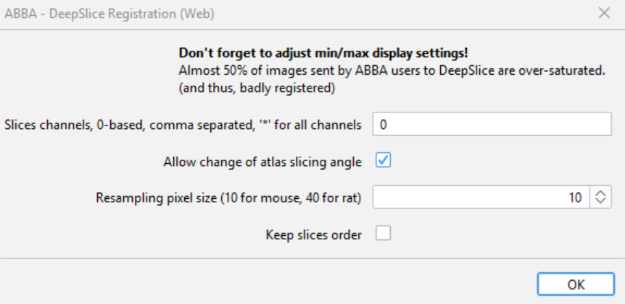
ABBA-DeepSlice registration
ABBA支援一次對所有切片做對位，但這樣可能導致有偏轉的切片對位結果不好，若追求精準度建議一次一張做
Select slice (每次選一張)
Register/Deepslice/Deepslice registration(Web)

Slide 12
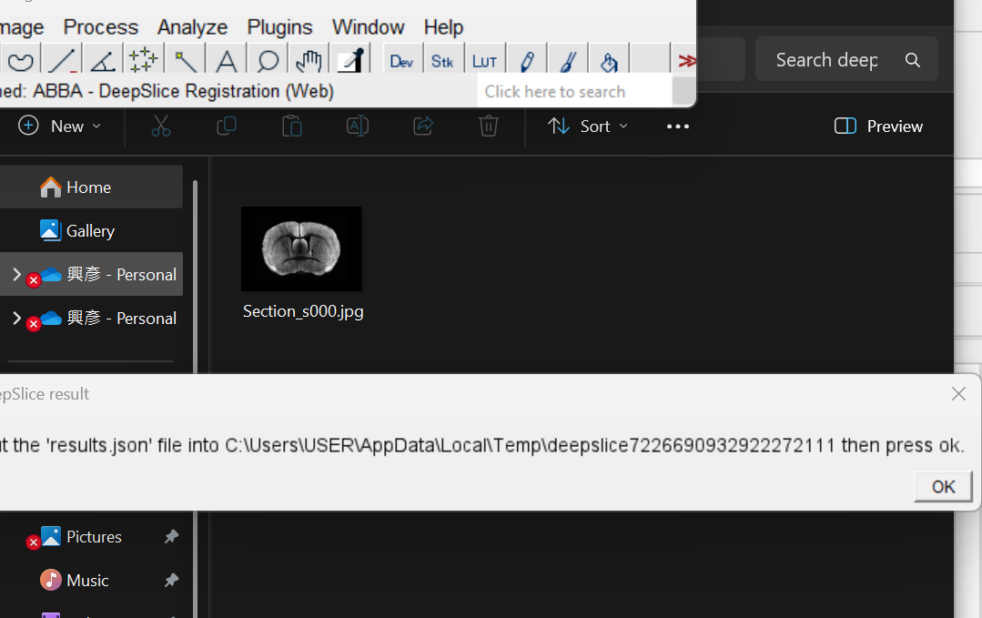
ABBA-DeepSlice registration
Drag the picture to the webpage
Submit and download the json result
Copy the result to the original folder and press OK

Slide 13
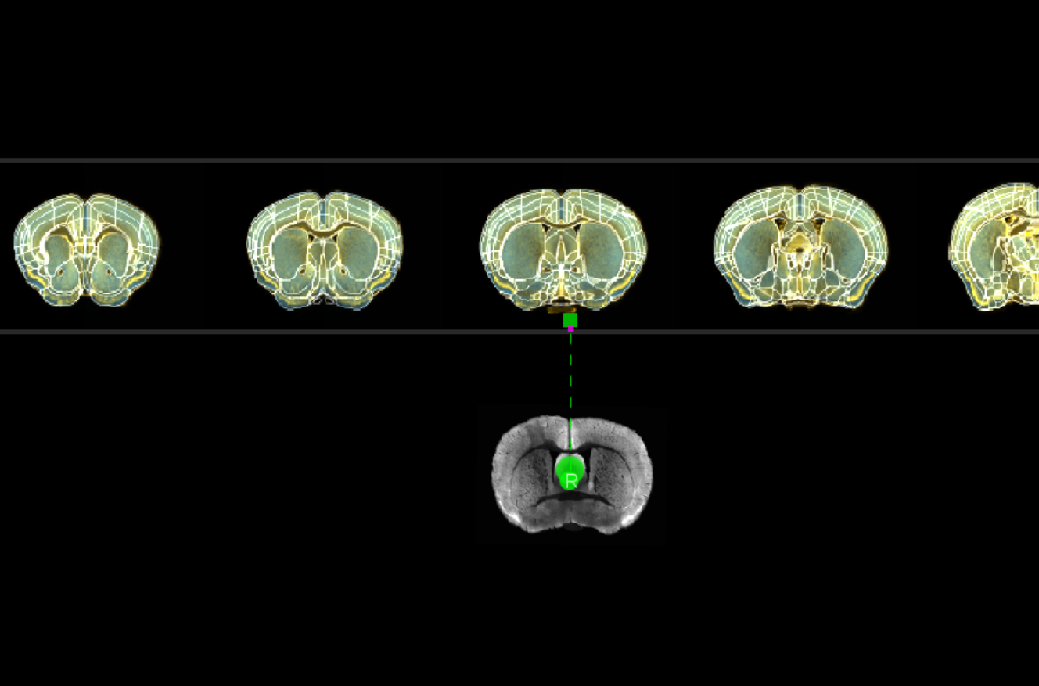
ABBA-DeepSlice registration
跑完後切片應跑到deepSlice預測的位置。若預測不好需選取切片手動拖拉至正確位置

Slide 14
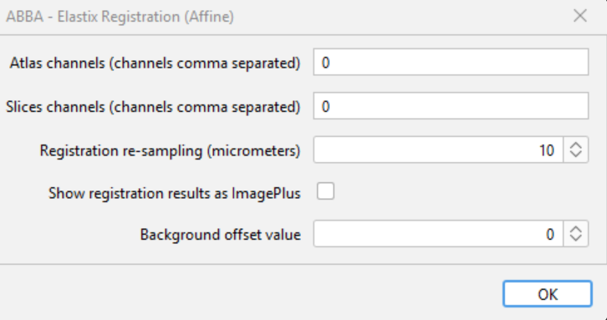
ABBA-Elastix registration
Select slice
Register/Affine/Elastix registration

Slide 15
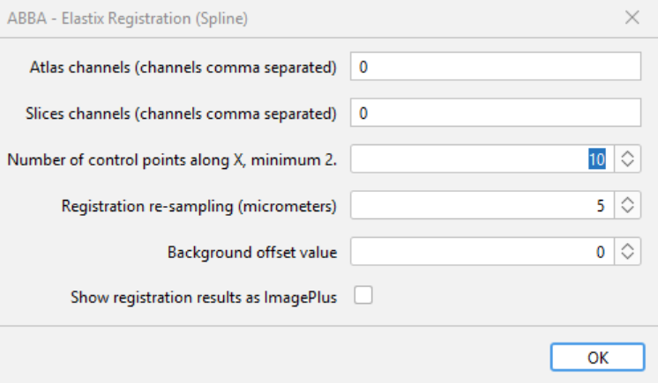
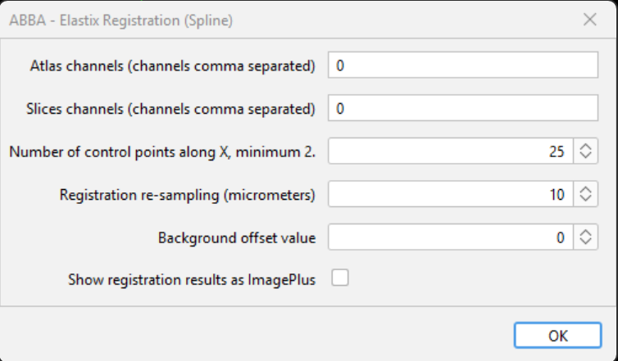
ABBA-Elastix registration
3. Register/Spline/Elastix registration
(Optional) 若希望Spline結果更好可以做兩次，第一次使用較少Number of control points along X (10)，第二次較多(25)。

Slide 16
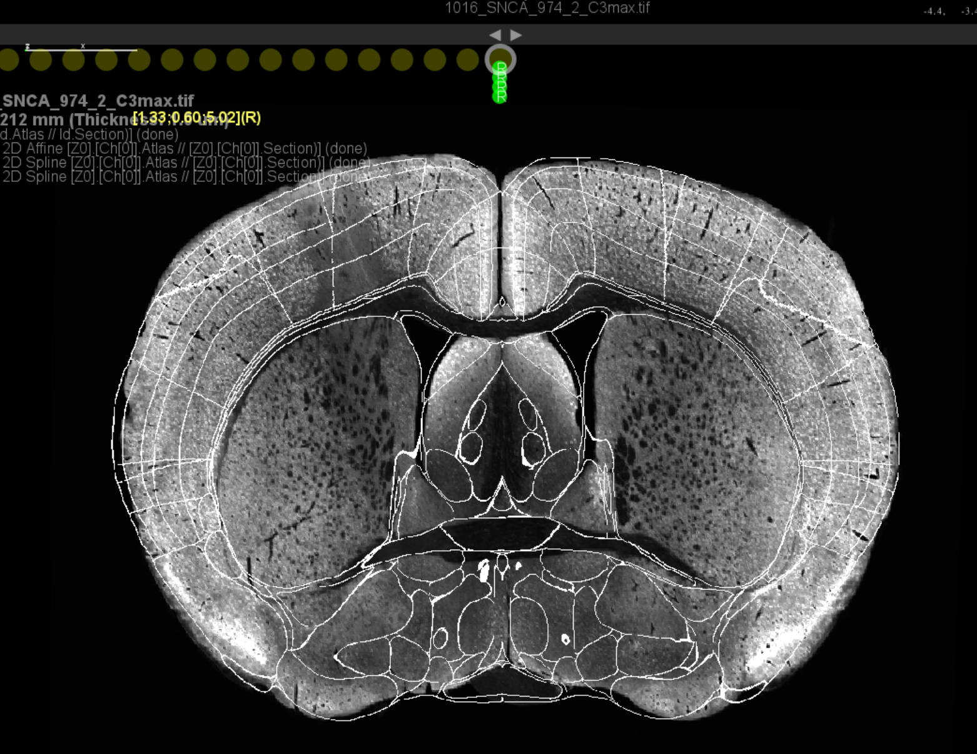
ABBA-review
Right bar/Display&Navigation/Modes/Review 查看對位結果

Slide 17
ABBA-export
若結果沒問題
Export/Qupath/Export registration to qupath project
匯出後即可重複上述步驟，開始對位下一片切片
若匯出前直接跑下一片對位會讓切片預測角度歪掉，造成結果不佳

Slide 18
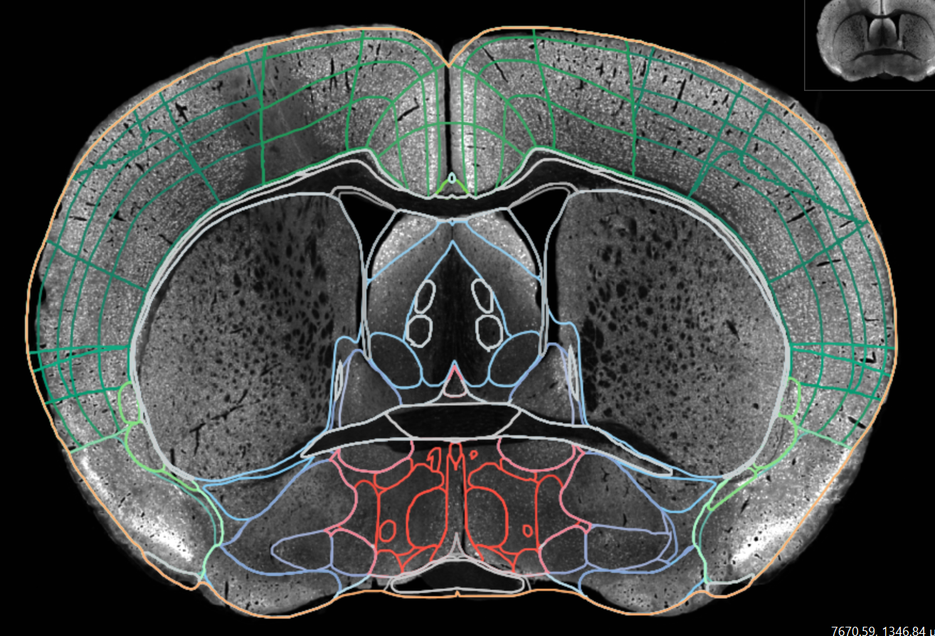
Load registration to qupath
Qupath/Extensions/ABBA/Load Atlas Annotation into Open Image

Slide 19
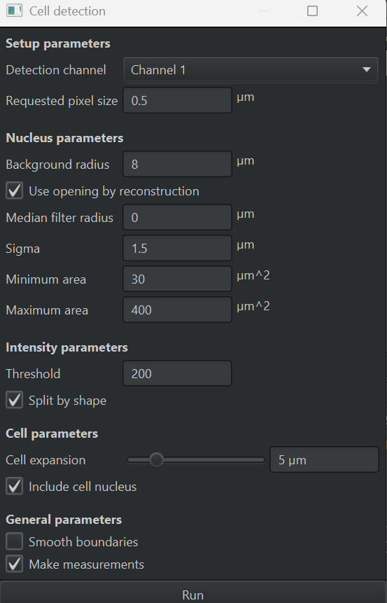
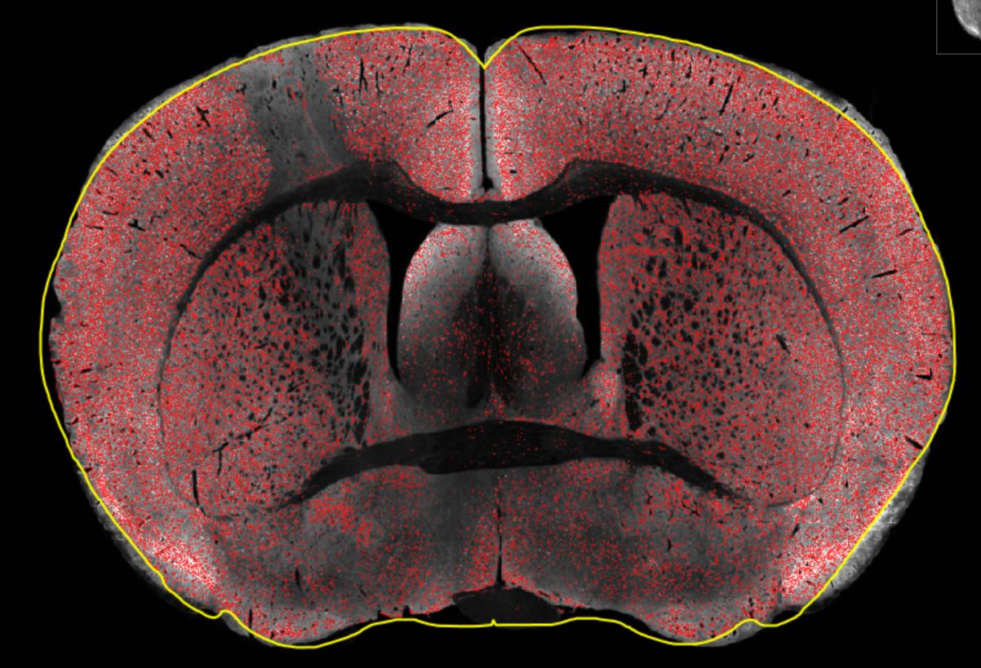
Cell detection
Left bar/Hierarchy/Root 選取root annotation
Top bar/Analyze/Cell detection/Cell detection
Threshold-判斷細胞門檻-根據圖片調整
Min/Max area-調整希望偵測細胞大小

Slide 20
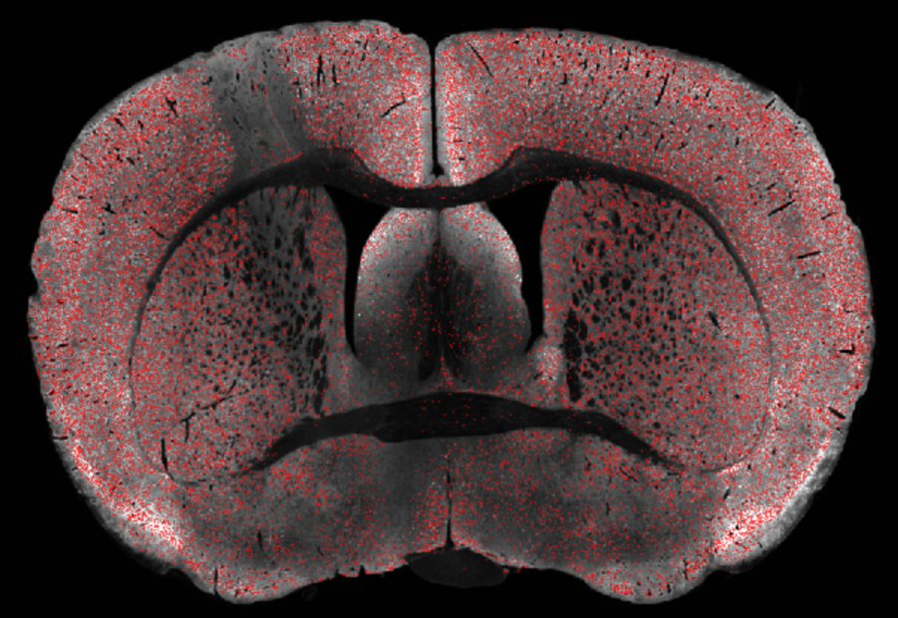
Import registration
Right bar選取 Root annotation
Right click/delete object
keep descendant objects?->yes
result
由於qupath設計做cell detection會清除 Annotation內部結構，必須將原本的 annotation移除並重新load

Slide 21
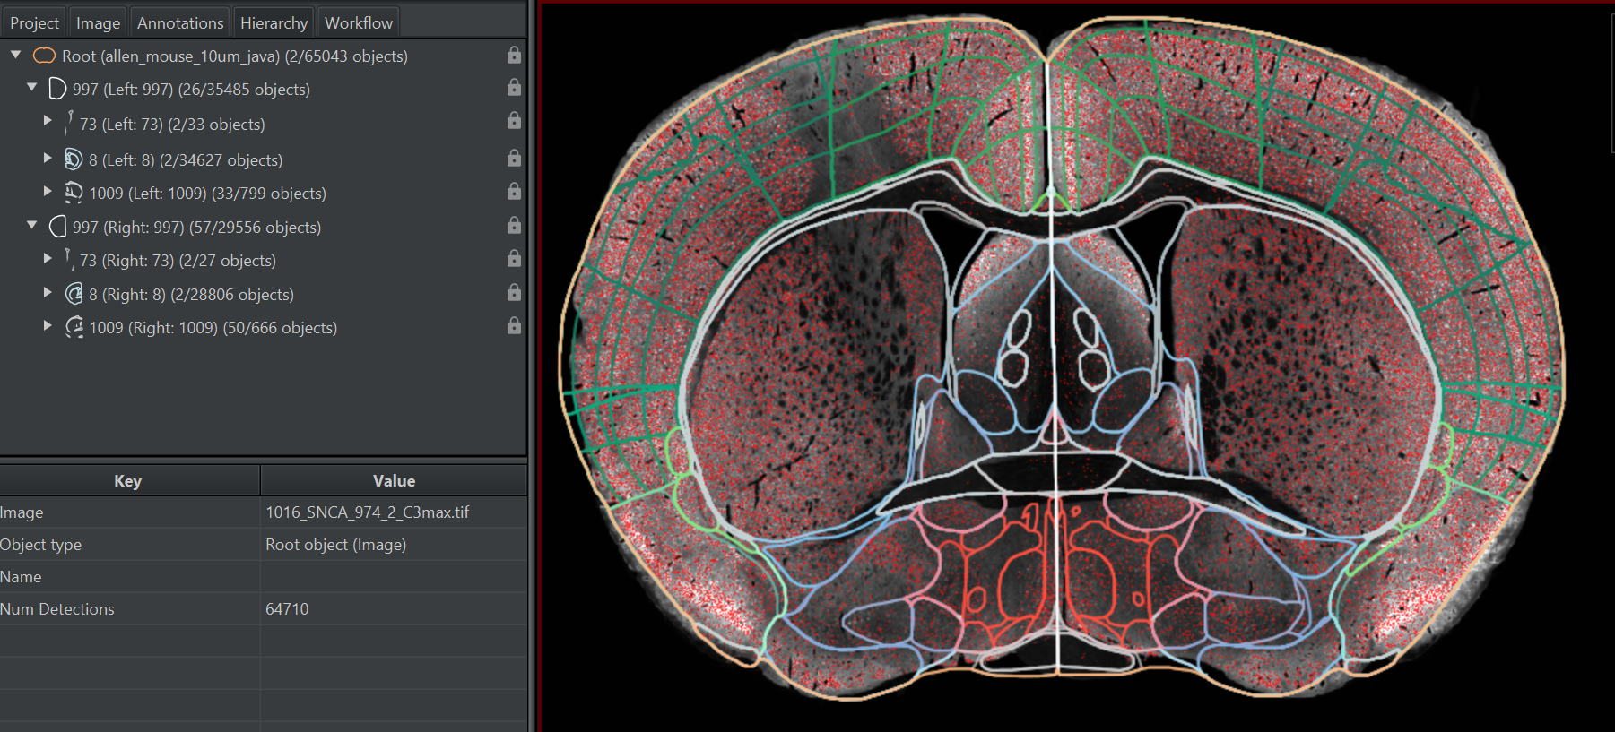
Reload registration to qupath
Qupath/Extensions/ABBA/Load Atlas Annotation into Open Image
Objects/Select/select detections/select all detections
Object/Annotation/Insert into hierarchy
可看到右邊Hierarchy內出現各區細胞統計

